Slide 1
Object Oriented Programming (OOP)
Week – 08
Dated: 30/10/2024
Instructor: Dr. AHMED AWAIS

Slide 2
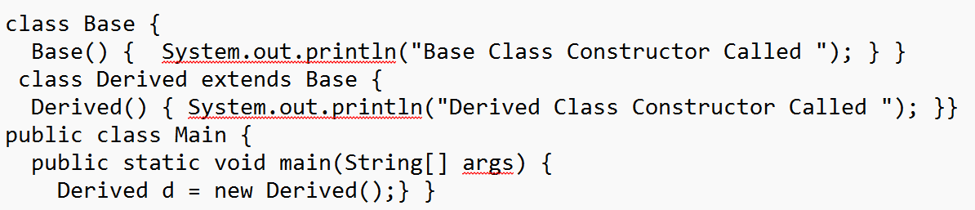
Inheritance and constructors in Java
In Java, constructor of base class with no argument gets automatically called in derived class constructor.
For example, output of following program is:
Base Class Constructor Called Derived Class Constructor Called

Slide 3
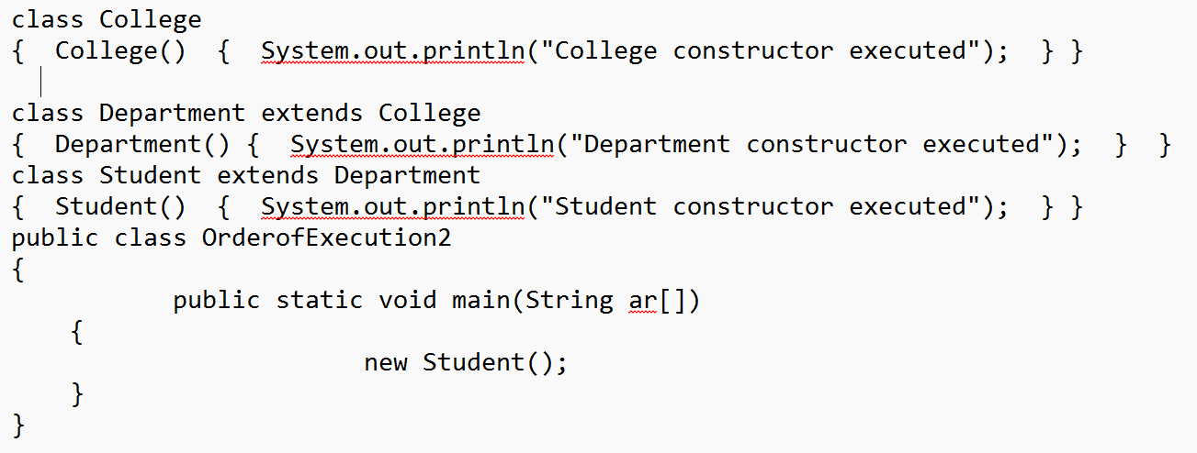
Order of execution of constructor in Multilevel inheritance – Constructor Chain

Slide 4
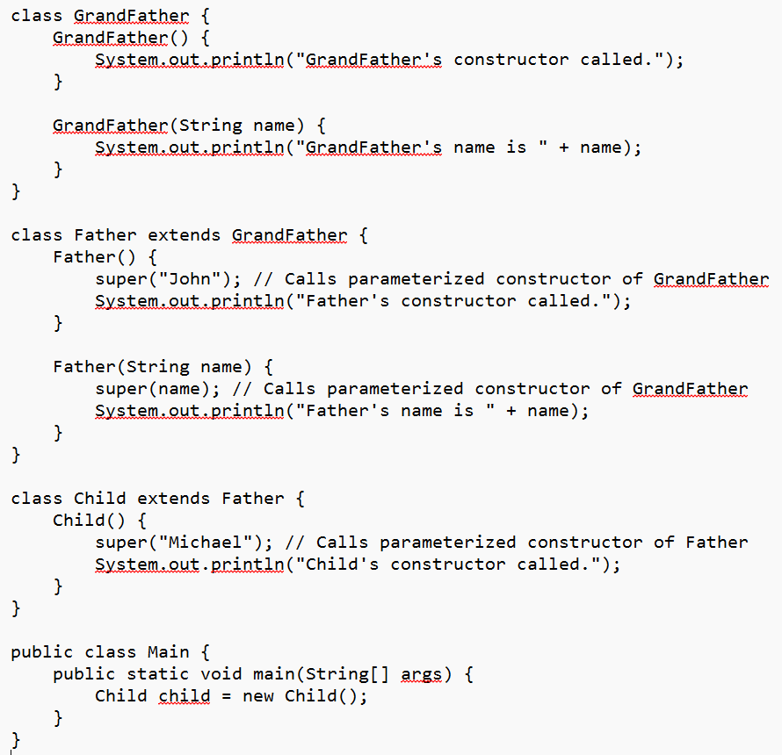

Slide 5
Order of Initialization: Constructors are called from the top of the inheritance hierarchy (GrandFather) down to the subclass (Child).
super() Requirement: If a super() call isn’t specified, Java automatically inserts a call to the default superclass constructor.
GrandFather's name is John
Father's name is Michael
Child's constructor called.

Slide 6
Calling superclass constructor using super keyword
class Base {
int x;
Base(int _x) { x = _x; }
}
class Derived extends Base {
int y;
Derived(int _x, int _y) { super(_x); y = _y;
}
void Display() {
System.out.println("x = "+x+", y = "+y);
}
}
public class Main {
public static void main(String[] args) {
Derived d = new Derived(10, 20);
d.Display(); } }

Slide 7
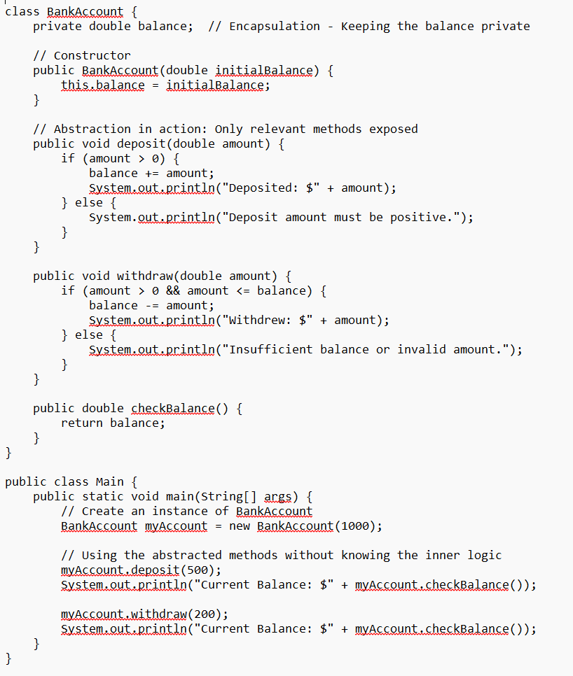
Abstraction
To implement abstraction simply, we can create methods that focus on hiding the inner workings of complex processes from the user. In this case, abstraction is achieved within a single concrete class by exposing only the relevant methods to the user, while keeping internal implementation details hidden.
Create a BankAccount class that abstracts the process of depositing, withdrawing, and checking balance. The class exposes a simplified interface to the user without revealing how these processes are managed internally. Here, we’re focusing on hiding complexity within the class itself.

Slide 8
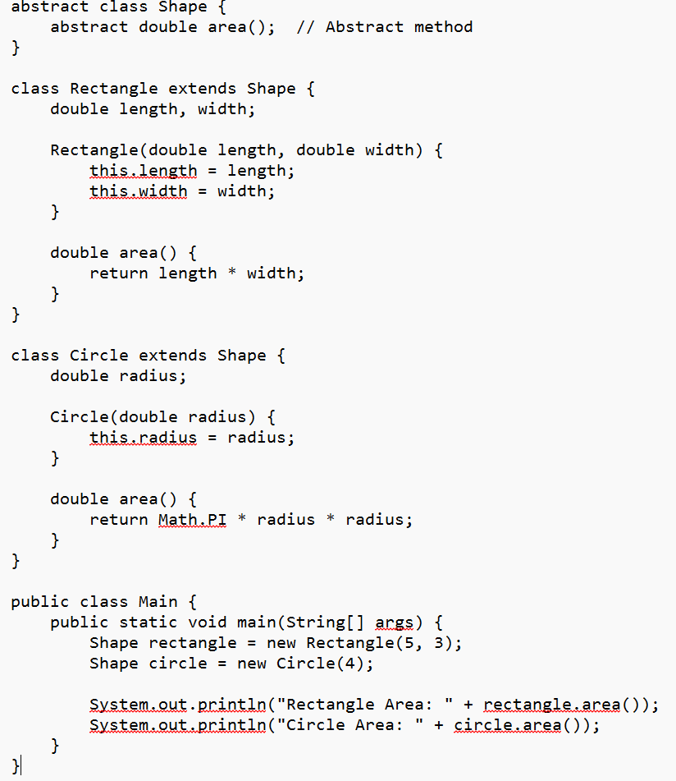
Abstraction
Define an abstract class Shape with an abstract method area(). Create subclasses Rectangle and Circle that extend Shape and implement the area() method. Calculate the area of each shape in the main method.

Slide 9
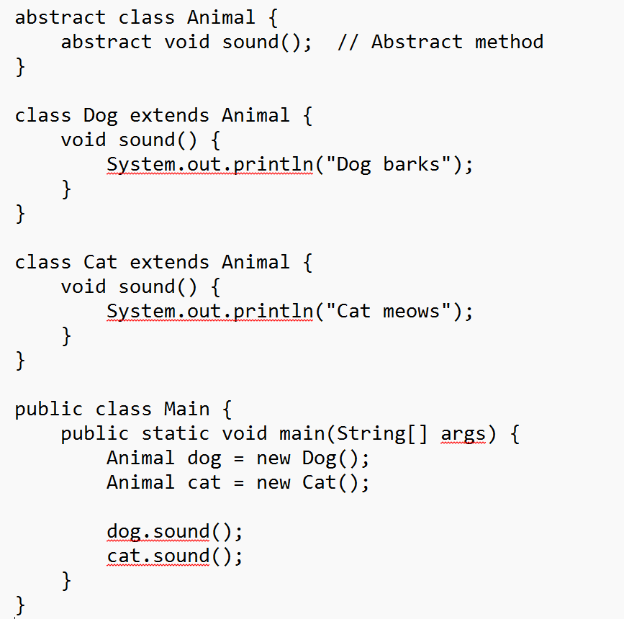
Abstraction
Create an abstract class Animal with an abstract method sound(). Implement subclasses Dog and Cat that define the sound() method differently for each animal. Demonstrate abstraction by calling sound() on each animal in the main method.

Slide 10
Activity Questions with Solution

Slide 11
Let’s understand by practicing different types of inheritance in Java, focusing on single, multilevel, hierarchical, and hybrid inheritance.

Slide 12
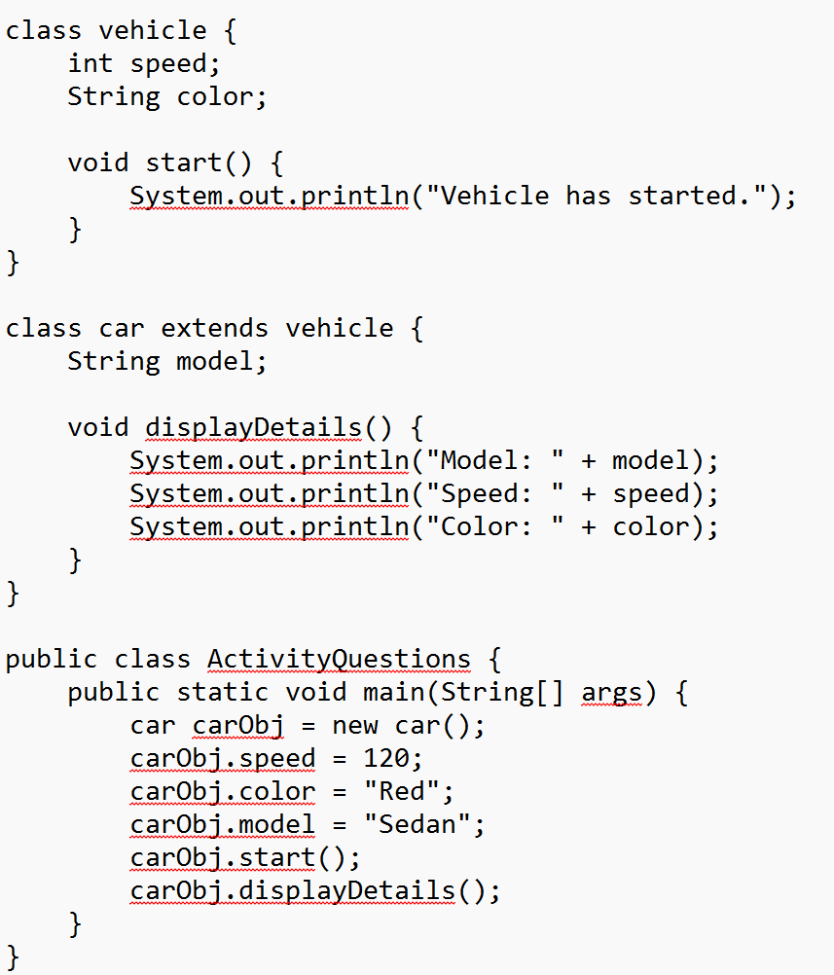
Single Inheritance
Create a superclass Vehicle with attributes like speed and color and a method start(). Create a subclass Car that inherits from Vehicle and has an additional attribute model. Implement a displayDetails() method in Car to print out all details, including the inherited attributes.

Slide 13
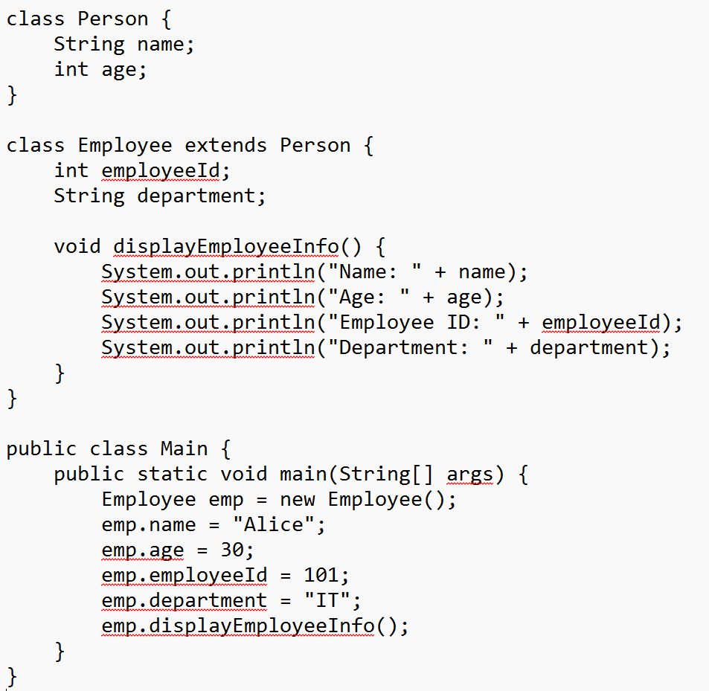
Single Inheritance
Write a superclass Person with attributes name and age. Create a subclass Employee that inherits from Person and has additional attributes employeeId and department. Write methods in Employee to display both personal and job details.

Slide 14
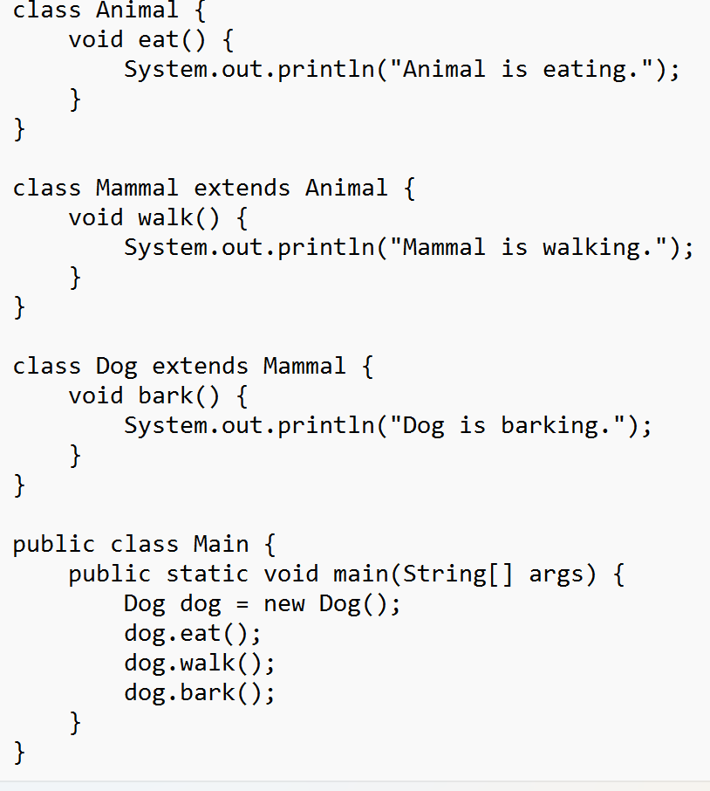
Multilevel Inheritance
Create a class Animal with a method eat(). Extend this class to Mammal with an additional method walk(). Then, create a Dog class that inherits from Mammal and adds a method bark(). Test the methods in the Dog class to demonstrate multilevel inheritance.

Slide 15
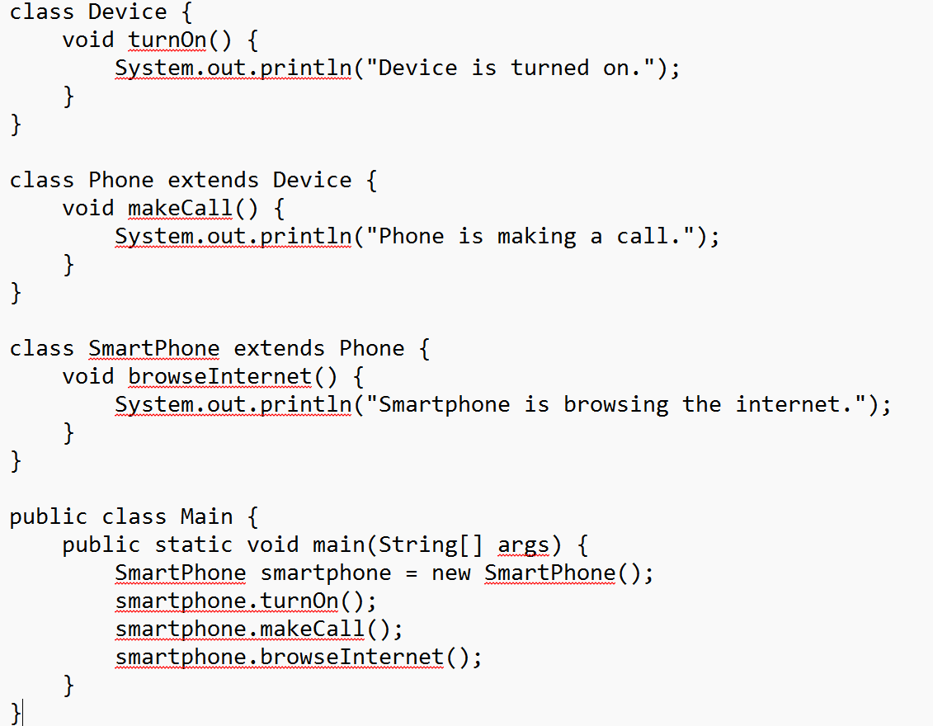
Multilevel Inheritance
Define a class Device with a turnOn() method. Create a Phone class that extends Device and has a method makeCall(). Further extend Phone into a SmartPhone class that adds a method browseInternet(). Write a main class to demonstrate how each method is accessible in SmartPhone.

Slide 16
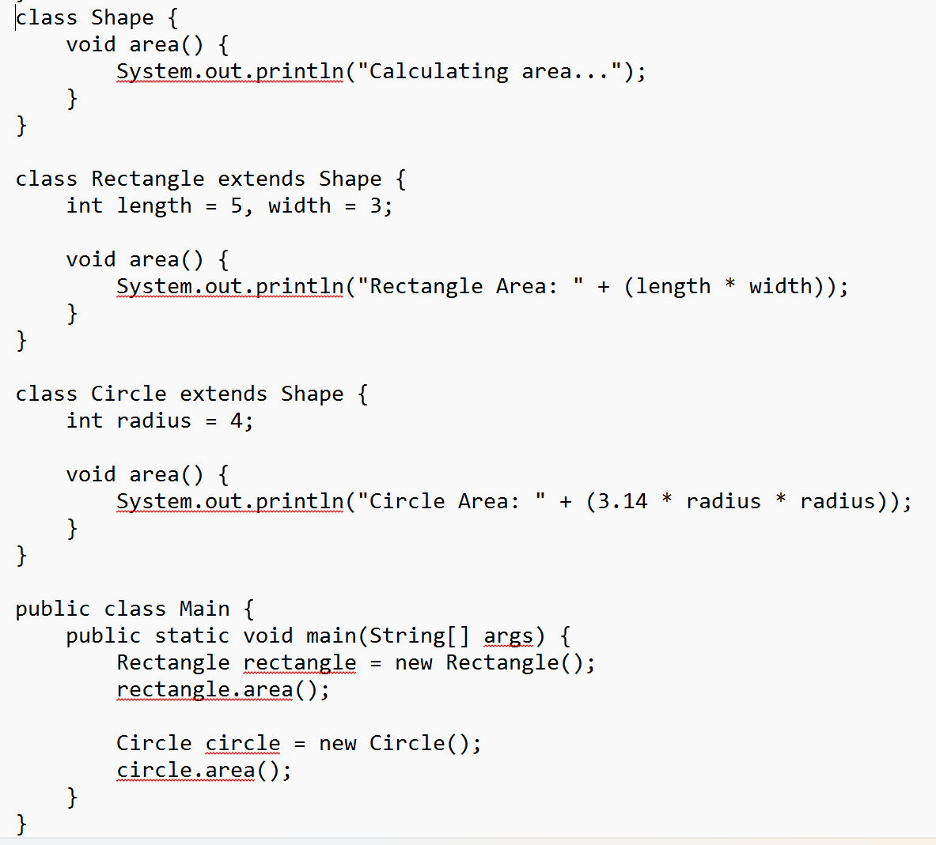
Hierarchical Inheritance
Define a base class Shape with a method area(). Extend Shape into two subclasses: Rectangle and Circle. Implement area() in both subclasses to calculate their respective areas. Write a main program to create instances of Rectangle and Circle, calling area() for each.

Slide 17
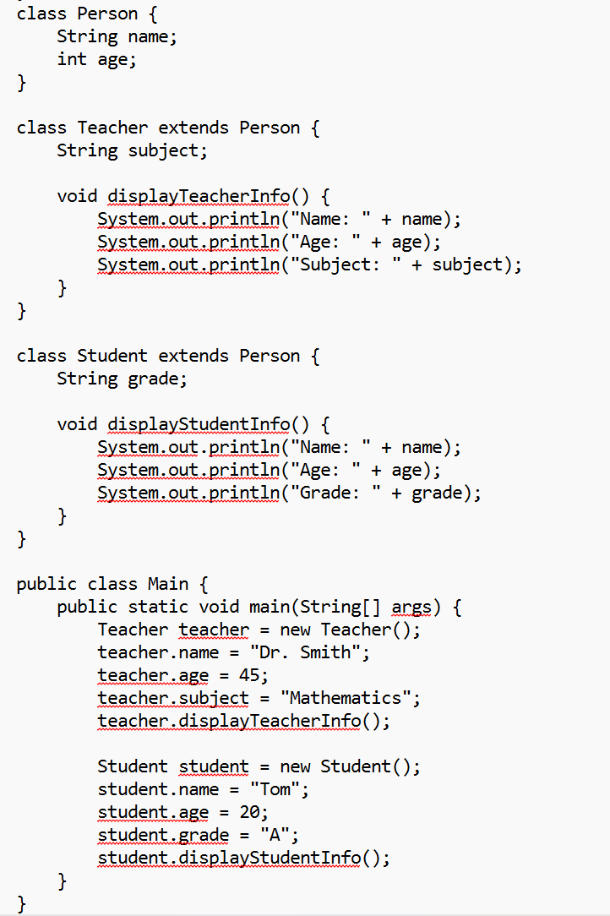
Hierarchical Inheritance
Create a class Person with attributes name and age. Extend Person into Teacher and Student. Add specific attributes to each class, like subject for Teacher and grade for Student. Write methods in each subclass to display the details. Instantiate both subclasses in the main method and call their methods to show hierarchical inheritance.

